Slide 1
Fake News Detection EEC 626 Software Engineering Project

Slide 2

HELLO!
Anubhuti Dayal
Oyindoubra J Timi
Software Engineering Graduate Student
a.dayal@vikes.csuohio.edu
o.timi@vikes.csuohio.edu

Slide 3

Are these for Real?
Disney World is removing Cinderella Castle
YouTube announced on its official Twitter account that it would be removing the ability to skip ads during videos.
Trump Tower Open in Pyongyang
Pepsi is celebrating its 119th birthday or anniversary by giving away free gifts on Facebook.
Leonardo DiCaprio donates $10 million to his grandmother's homeland Ukraine
An outgoing Twitter employee suspended Elon Musk’s account on their way out.
Before her death, Queen Elizabeth II specifically requested that former U.S. President Donald Trump was to be prohibited from attending her funeral.
Meta announced plans that they will soon begin charging people "this summer" to use Facebook.
Movie director Steven Spielberg has died
Universal Studios Florida at Universal Orlando Resort is closing permanently.
Notes:
Most of our time goes on social media and nowadays it is a fundamental source of the news & information as well ! But is it all true ??

Slide 4
INTRODUCTION
What is fake news?
“news articles that are intentionally and verifiably false” designed to manipulate people’s perceptions of real facts, events, and statements¹.
How is it harmful?
Fake news often has the aim of damaging the reputation of a person or entity, or making money through advertising revenue. It reduces the impact of real news by competing with it².
How to identify Fake news on social media?
Google it , read the article , Snopes.com, check other links on the page , read about the source , The excessive use of ALL CAPS or multiple exclamation points are clues that you are looking at fake news!!! Using ML also we can develop model to interpret.
¹. https://cits.ucsb.edu/fake-news/what-is-fake-news
². https://en.wikipedia.org/wiki/Fake_news
Notes:
Fake news are part of yellow journalism to manipulate any information , spread fake rumors to spoil the image of any person / institution.
People are making money , generating revenues through fake advertiesements.
Now the question is how to identify ?? How to segregate – well there are various websites are there like Snopes.com , you can google , check various resources , you can read the content and using Machine learning also you can identify fake news. Lets see how to do that

Slide 5
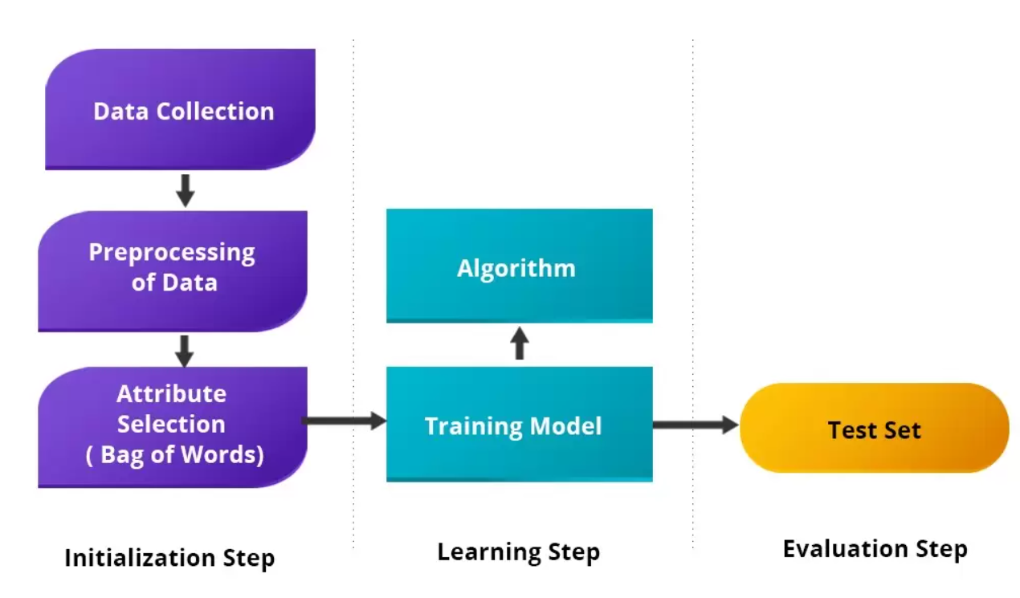
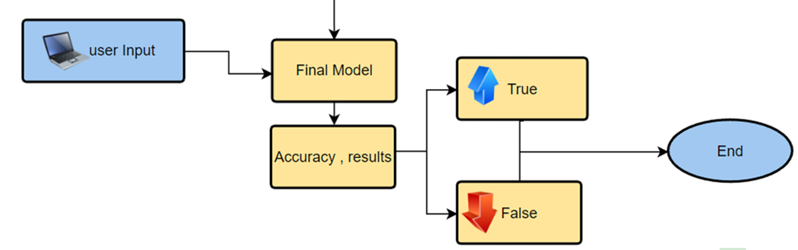
Data Analytic Goal
Developing machine learning algorithm to identify real vs. fake news from a data set.
Notes:
Goal of this project presentation is to identify fake news from the real news using ML .it follows various steps like getting the training set data , selecting features , then we Preprocess the data afterthat we have multiple classification theorems are available which we can use to train the model and check the accuracy

Slide 6
Data Description

Slide 7
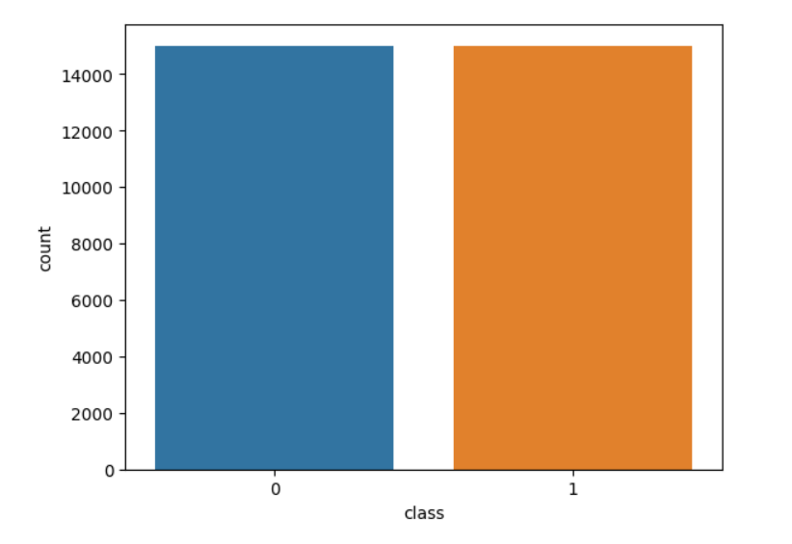
Data Source & Description
Source
www.kaggle.com
Data Size
Total : 31280
Data Balance
Fake 14977
Real 14994

Slide 8
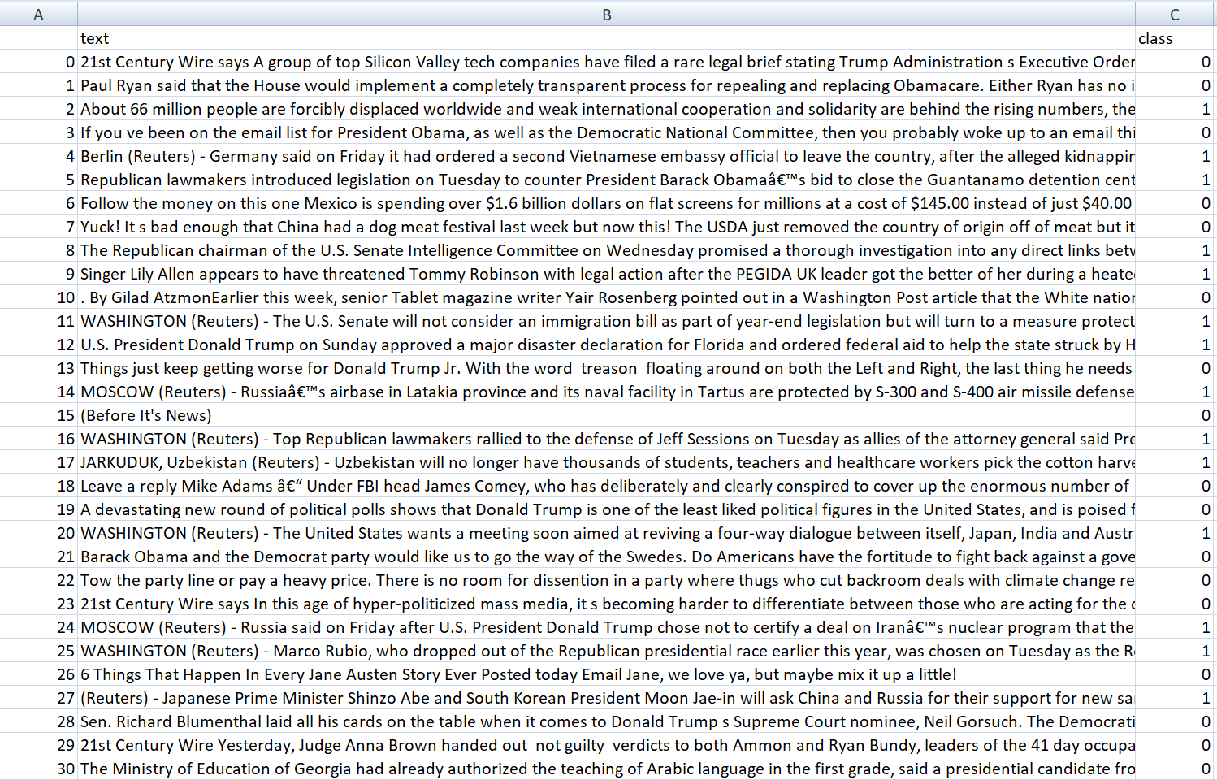
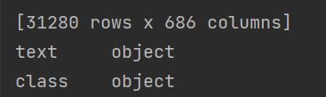
Features
Selected Features : text ,class
x

Slide 9






Systems/Tools
Windows 11
Python
PyCharm 2022.2.3 (Community Edition) IDE
Jupyter notebook
Matolib
Numpy
pandas

Slide 10
Data Preprocessing

Slide 11
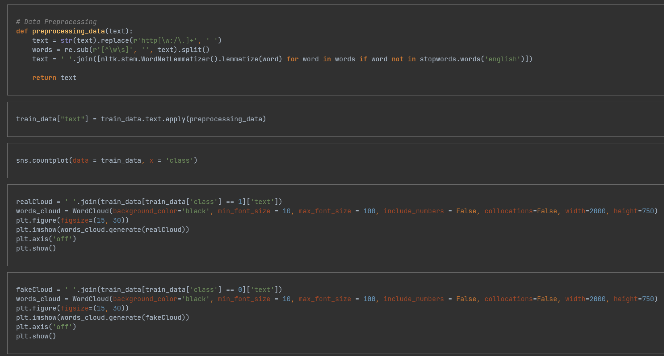
Preprocessing
Checking Nulls/blanks
Removing all hyper links
Checking Punctuations
Eliminating stop words
Generating word clouds
Generating Bigram
Generating Trigram
Lower case conversion

Slide 12
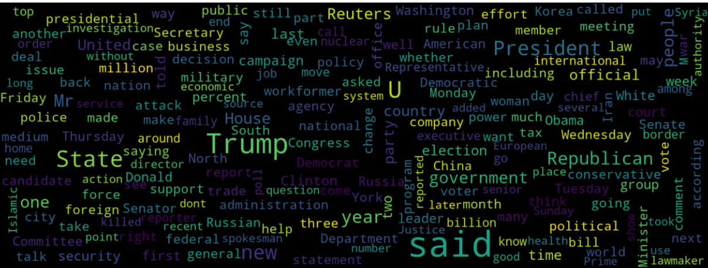
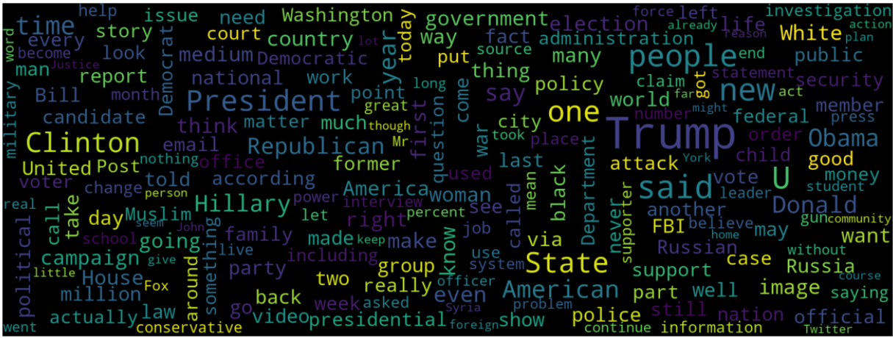
Word Cloud
Real
Fake

Slide 13
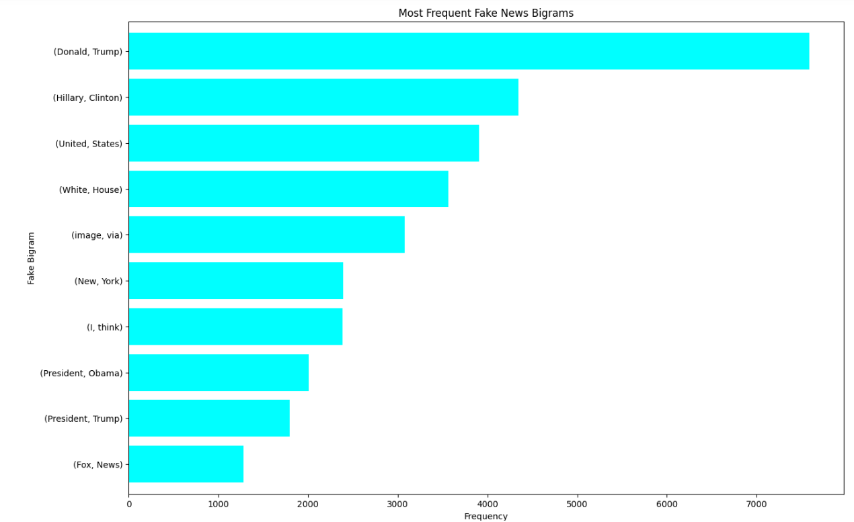
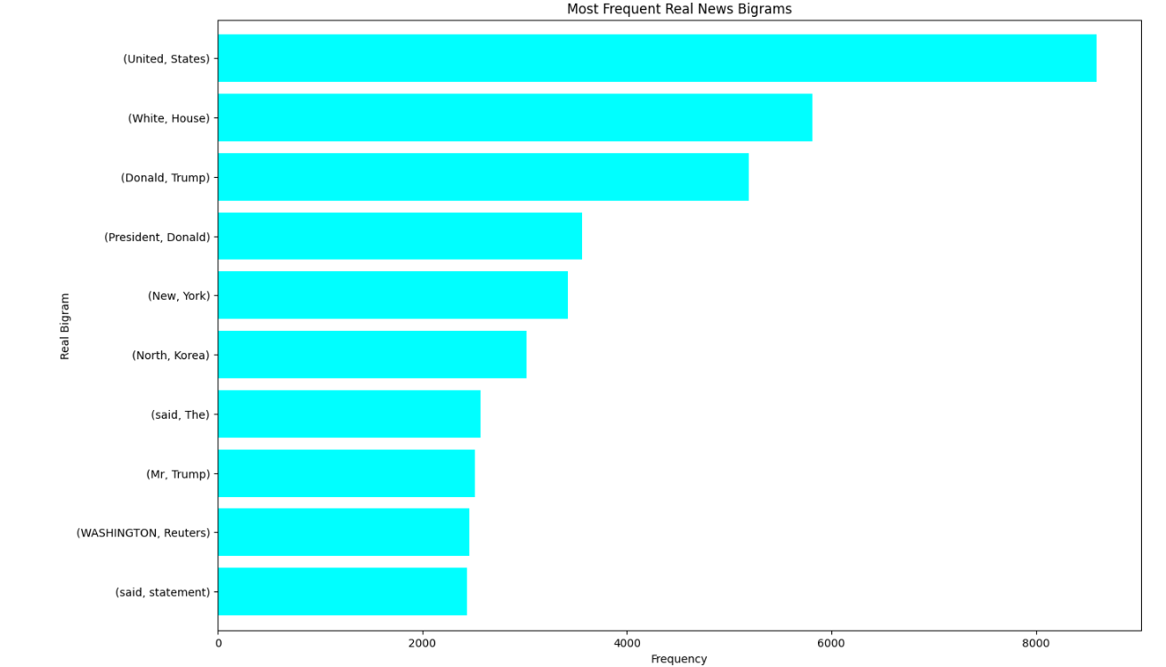
Bigram
Fake
Real
A bigram is a sequence of two adjacent elements from a string , like “please turn”, “turn your”, or ”your homework”

Slide 14
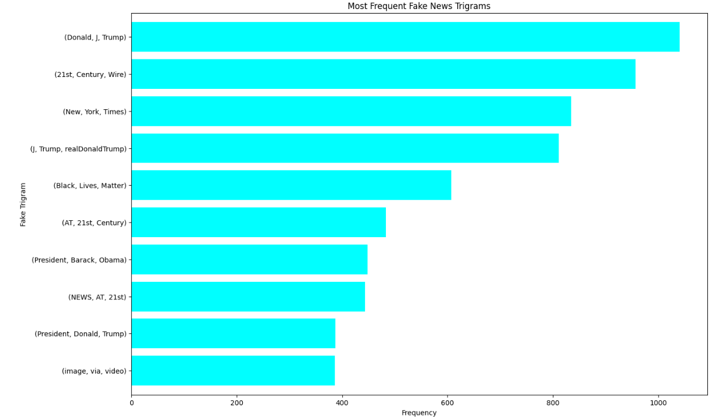
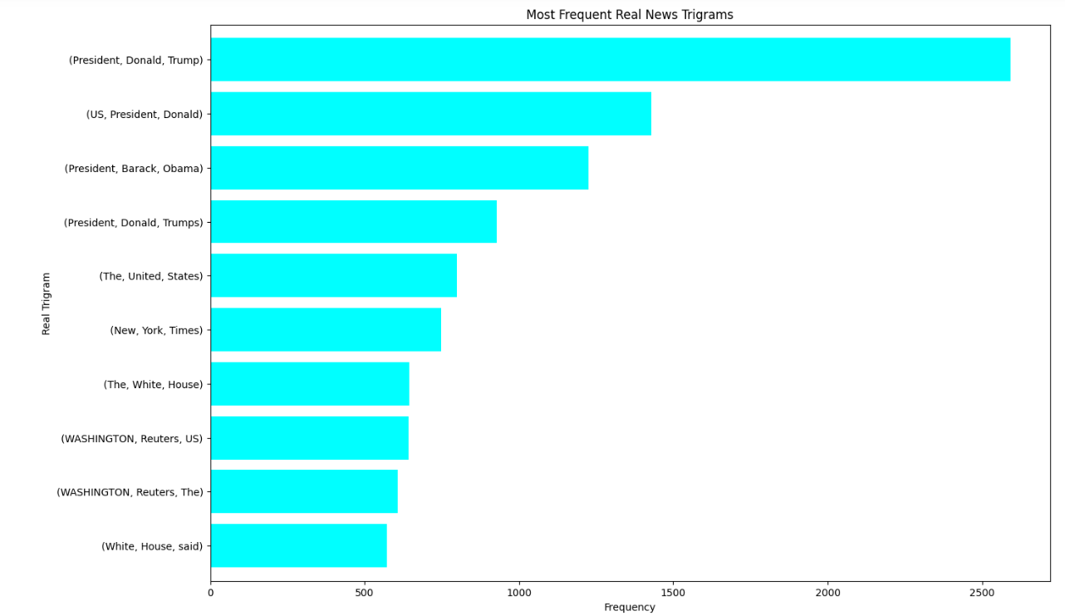
Trigrams
Fake
Real
A trigram is a sequence of three adjacent elements from a string , like “please turn your”,
or “turn your homework”

Slide 15
Model Generation

Slide 16
Multinomial Naive Bayes Algorithm
Multinomial Naïve Bayes uses term frequency i.e. the number of times a given term appears in a document.
It is used to classify textual input and cannot be used to estimate numerical values.

Slide 17
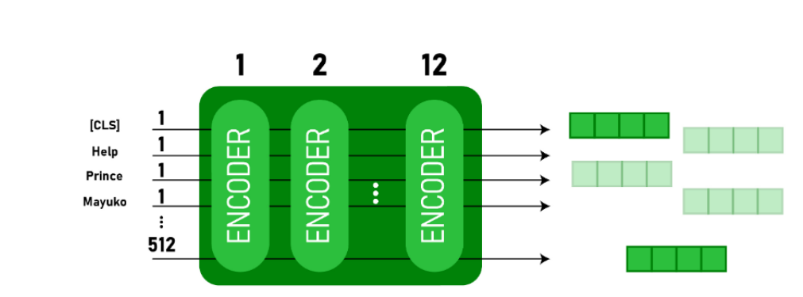
BERT Model
BERT, which stands for Bidirectional Encoder Representations from Transformers, is based on Transformers.
A deep learning model in which every output element is connected to every input element, and the weightings between them are dynamically calculated based upon their connection.
https://towardsai.net/p/l/fake-news-detection-using-bert-model-python

Slide 18
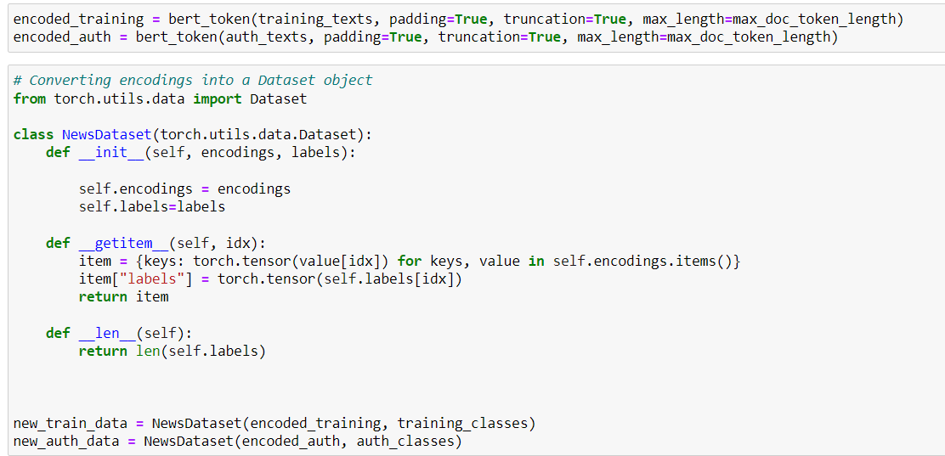
Conversion of words to Encodings

Slide 19
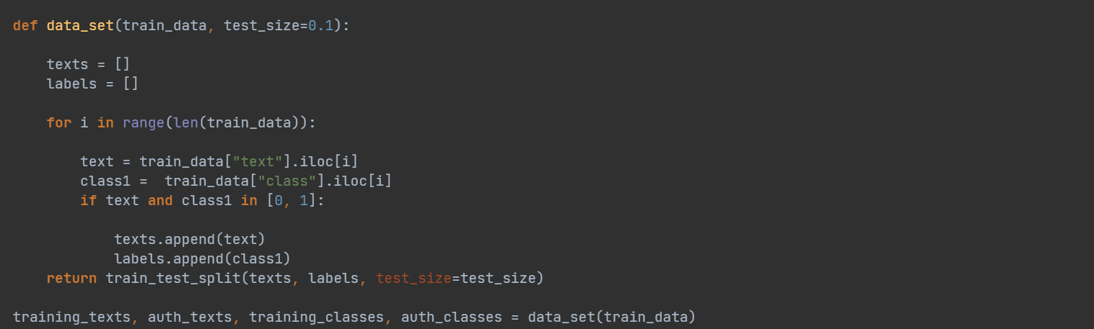
Training Set and Test Set
10 % Test Size
90% Training Size

Slide 20
Results

Slide 21
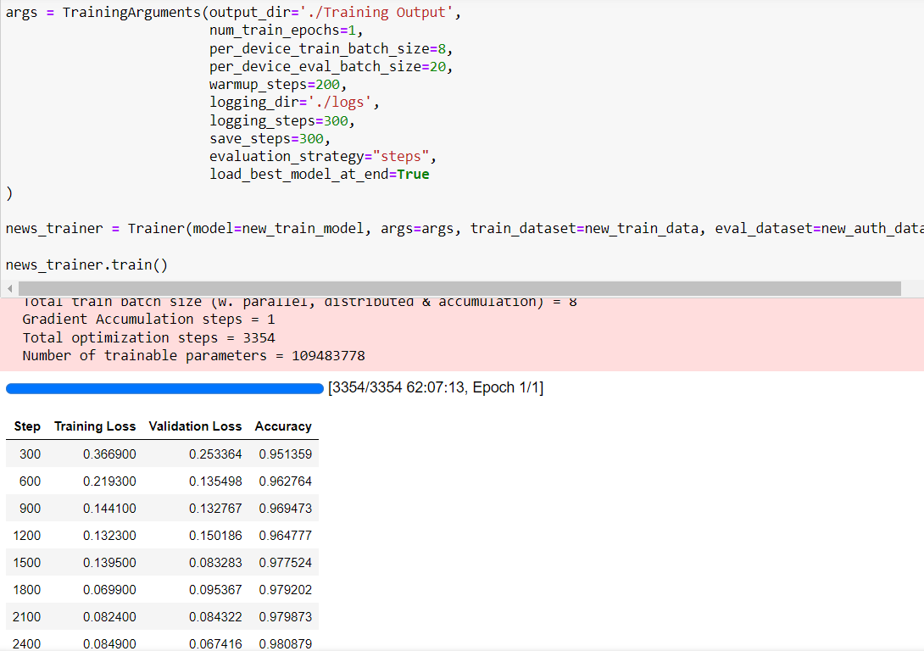
Model : Training Results

Slide 22
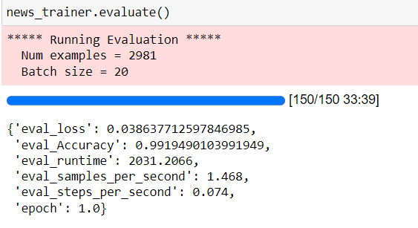
Training Evaluation

Slide 23
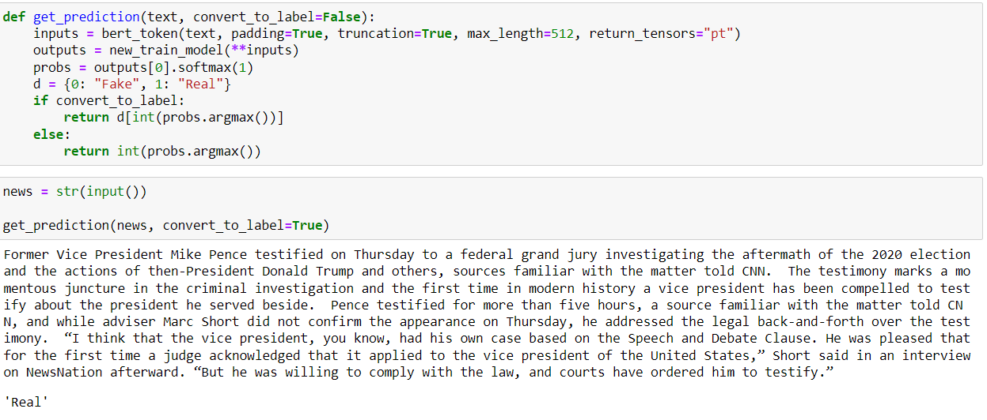
Results Evaluation

Slide 24

Problems/Errors Encountered
Using Training Datasets with Insufficient Data was giving ambiguous results
Resolution : Used different data set, merged multiple data set with sufficient
counts & proper balance between fake and Real to Train the model with
better accuracy.
Takes lot of time to train the model and see the results and then again
modify and see next iteration results.
Also tried with Neural network – where accuracy was stuck to 50% only.

Slide 25
THANKS!
Any Questions???

